Slide 1
Text mining and sentiment analysis
Geog4300/6300
Jerry Shannon

Slide 2
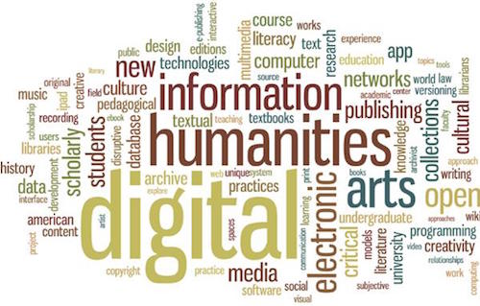
Notes:
How are these different?

Slide 3
Text mining
Text-mining techniques can take numerous forms, but at base they attempt to find—and often quantify—meaningful language patterns spread across large bodies of text. If a historian, for example, wanted to understand how Northerners and Southerners discussed Abraham Lincoln during the American Civil War, he or she could mine digitized historical newspapers to discover how discussions of Lincoln evolved over time in those newspapers (looking for every instance of the word “Lincoln” and the constellation of words that surrounded it).
Torget AJ, Mihalcea R, Christensen J, Mcghee G. Mapping Texts: Combining Text-Mining and Geo-Visualization To Unlock The Research Potential of Historical Newspapers
Notes:
How are these different?

Slide 4
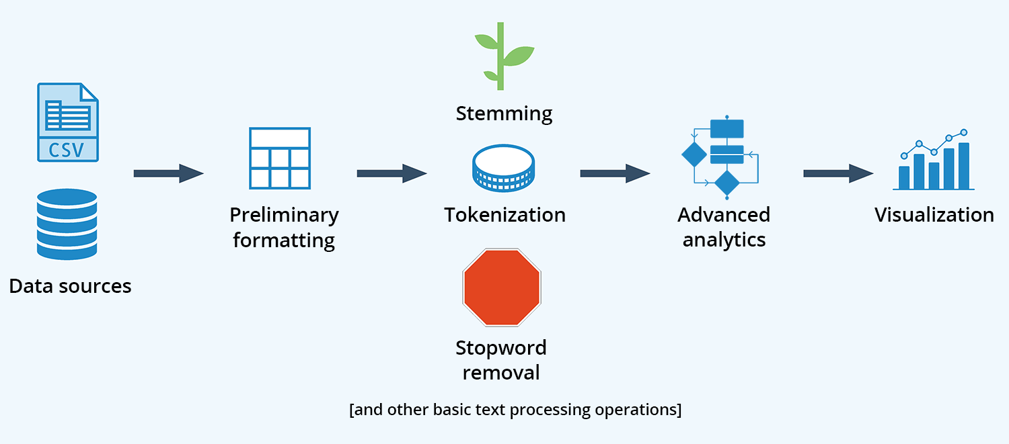
https://www.softwareadvice.com/resources/what-is-text-analytics/
Notes:
How are these different?

Slide 5
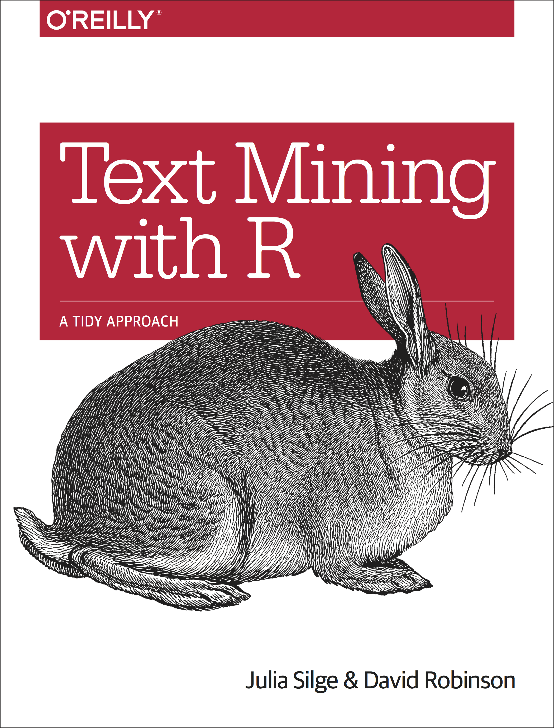
https://www.tidytextmining.com/index.html
Notes:
How are these different?

Slide 6
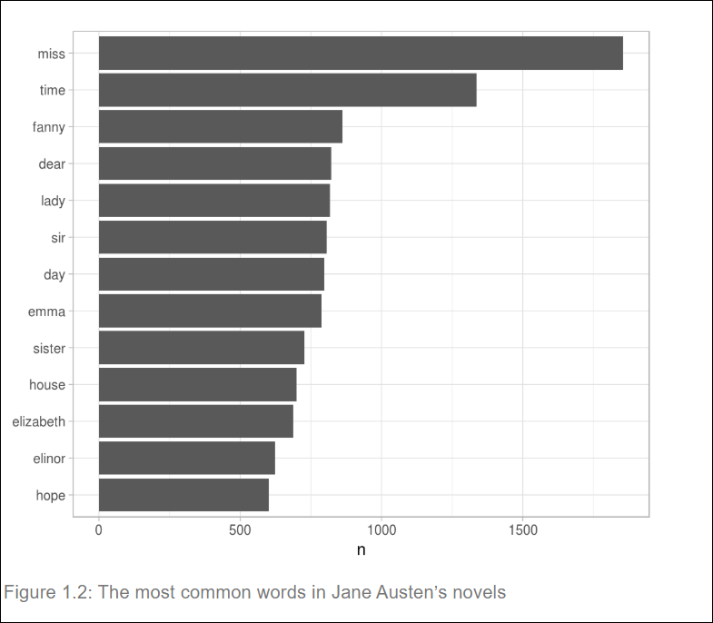
Notes:
How are these different?

Slide 7
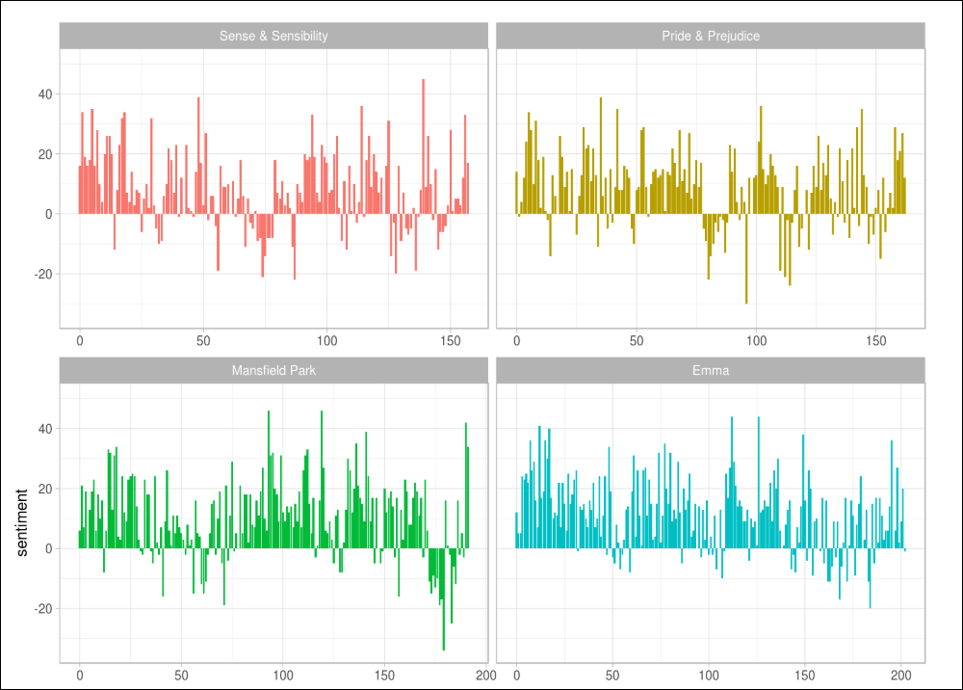
Notes:
How are these different?

Slide 8
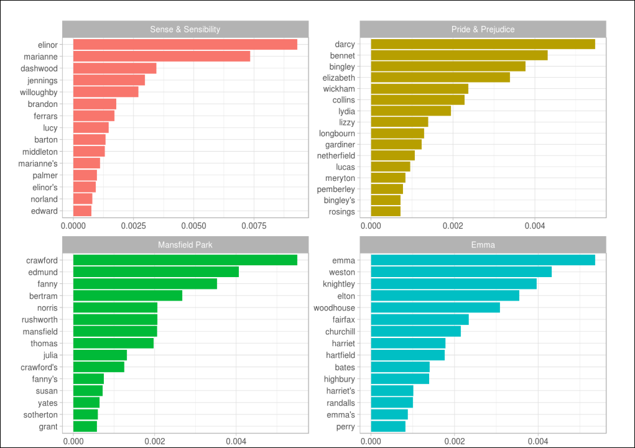
Tf-idf: What words are uniquely important?
Notes:
How are these different?

Slide 9
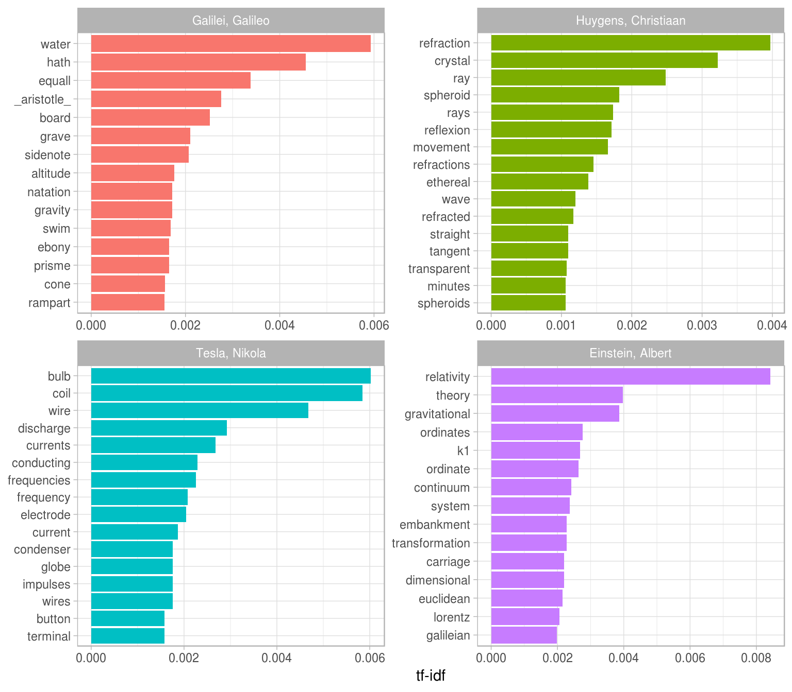
Notes:
How are these different?

Slide 10
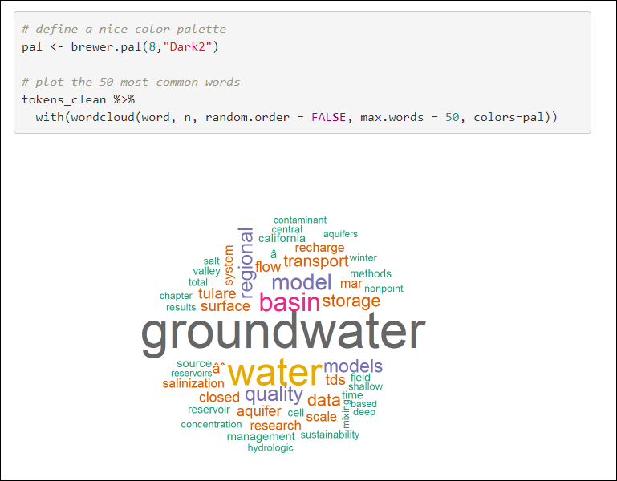
Notes:
How are these different?

Slide 11
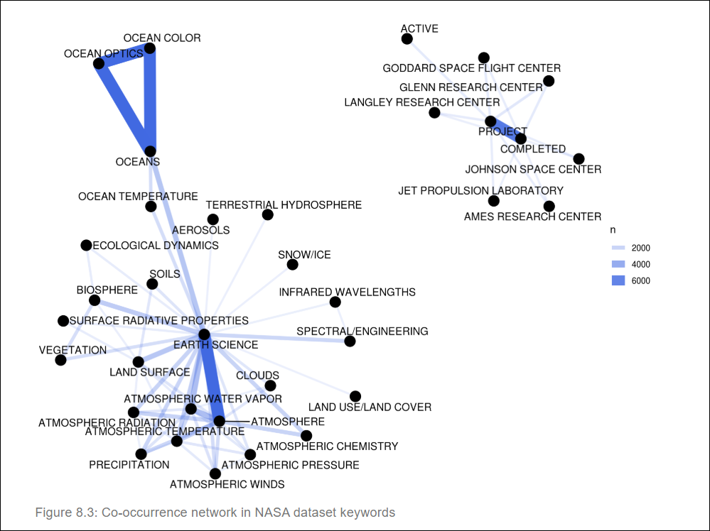
Word networks
Notes:
How are these different?

Slide 12
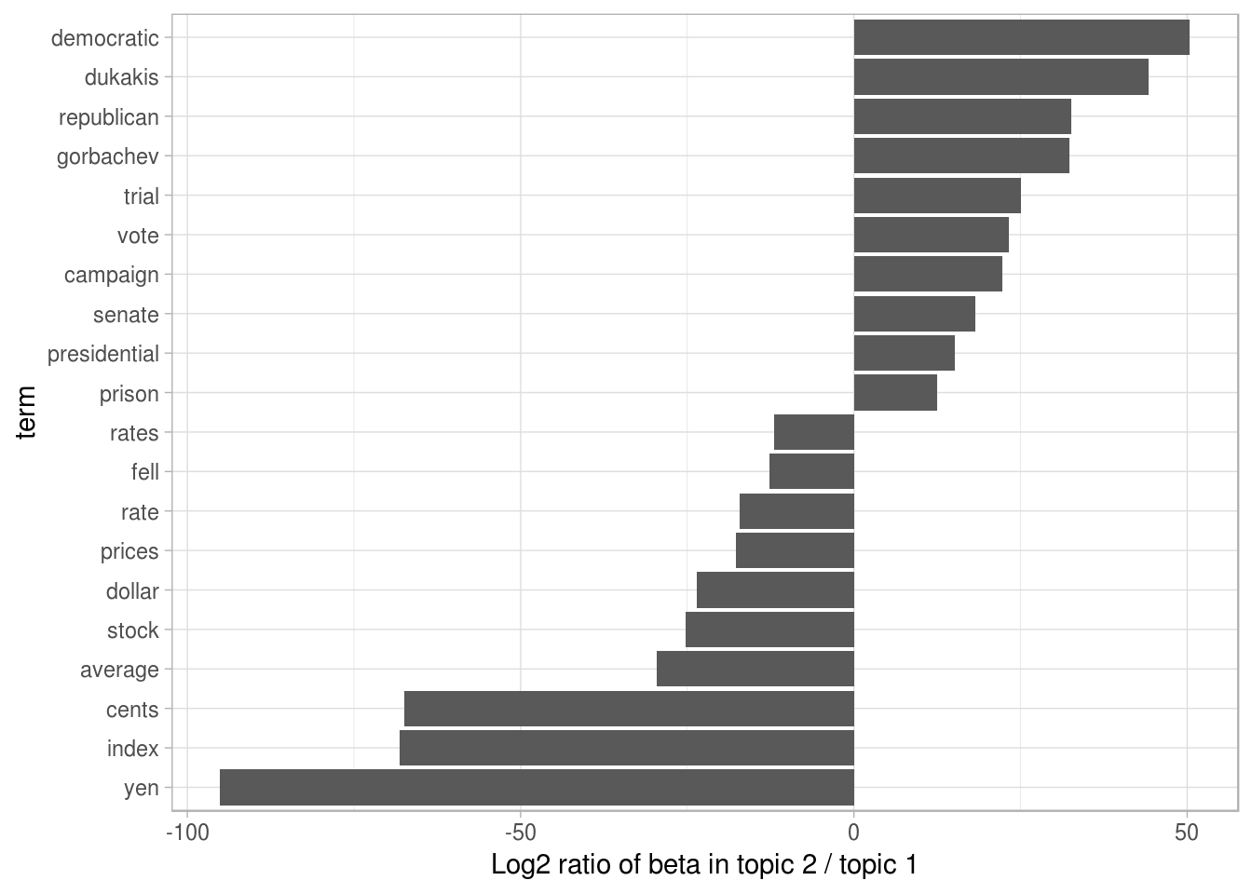
Topic modeling:
AP news stories
Notes:
How are these different?

Slide 13
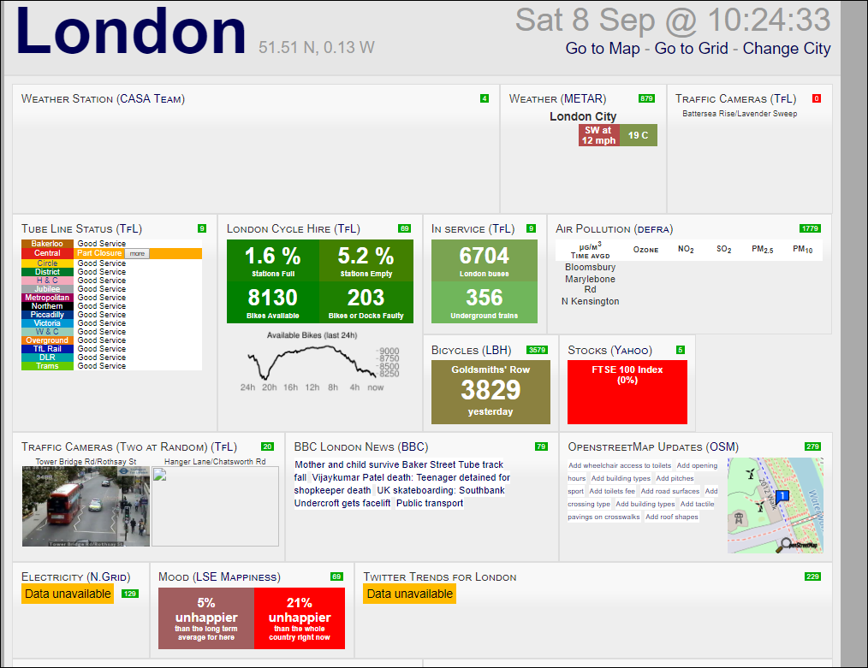
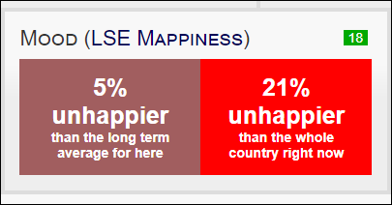
Sentiment analysis
Notes:
How are these different?

Slide 14

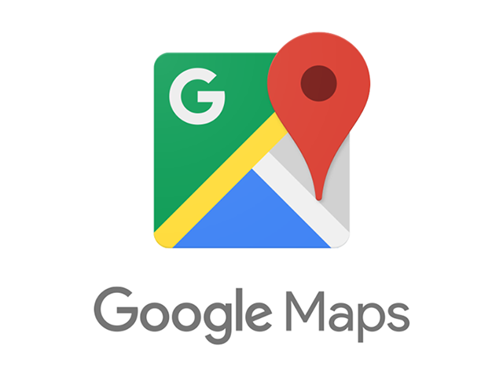
Words in a good or bad restaurant review?
Notes:
How are these different?

Slide 15
Calculate the sentiment of a restaurant in Athens
Notes:
How are these different?

Slide 16
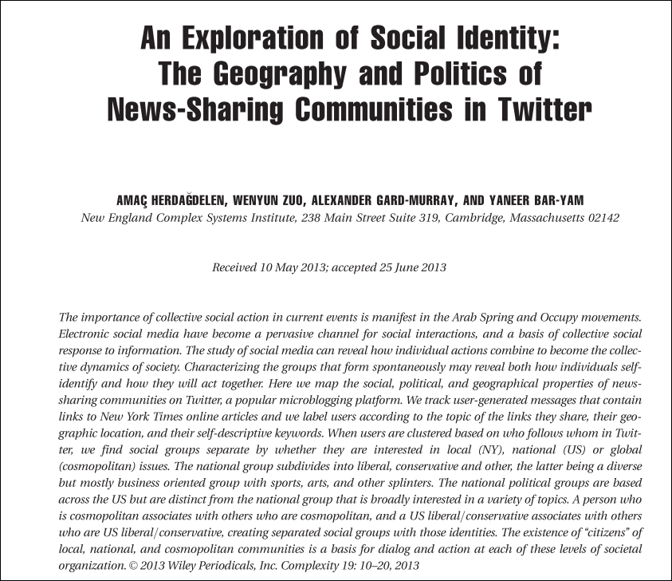
Notes:
How are these different?

Slide 17
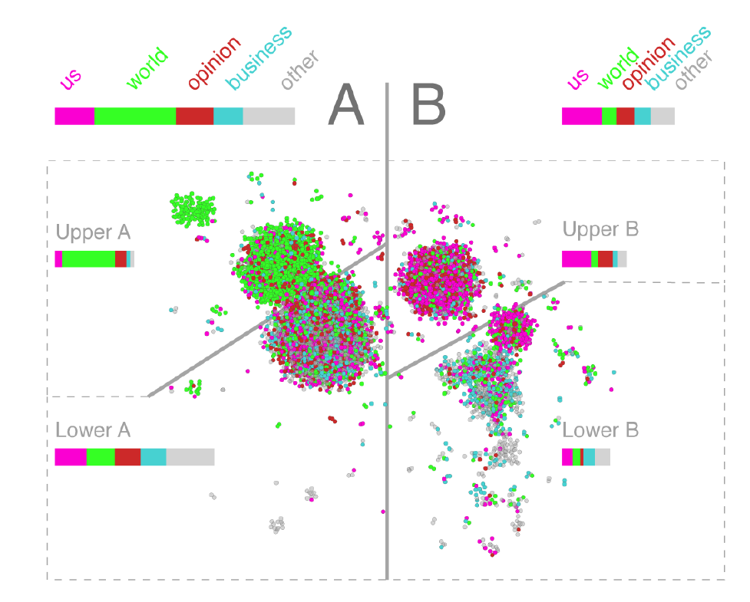
Notes:
How are these different?

Slide 18
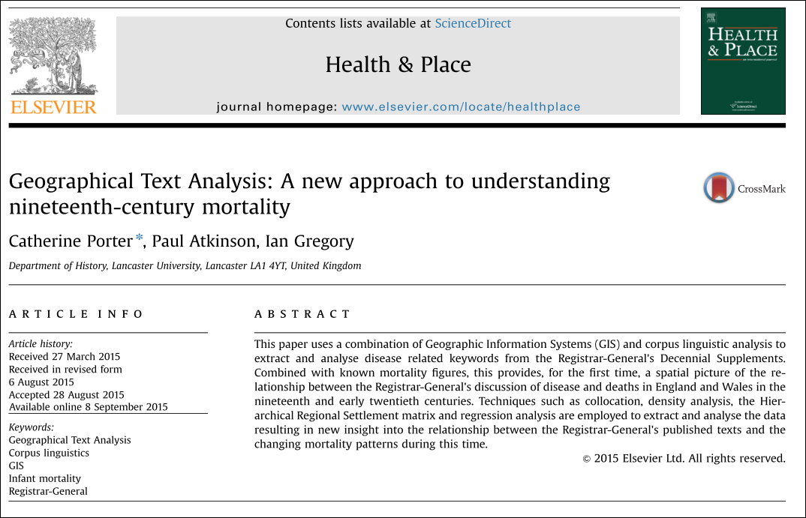
Notes:
How are these different?

Slide 19
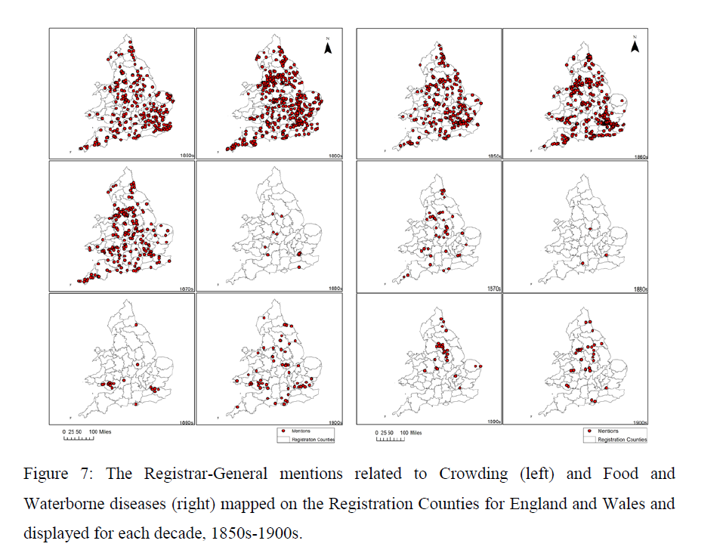
Notes:
How are these different?

